Slide 1
S T Lee Lecture
Cambridge, 28 November 2013
Helga Nowotny
The odds for tomorrow: promises, policy and
the publics under conditions of uncertainty

Slide 2
The odds for tomorrow
Between fear and confidence
What is a promise and what does it do
Policy – options and impact
Publics and collective imaginaries
The cunning of uncertainty

Slide 3
Between fear and confidence
What is a promise and what does it do
Policy – options and impact
Publics and collective imaginaries
The cunning of uncertainty

Slide 4
Craving for certainty
Prophesies and predictions
Long waves; cycles of boost and bust
Unintended consequences of intentional human action
Change not only of society, but of knowledge about it and nature

Slide 5
Changing profiles of fear
J.Delumaux, Les peurs aux moyen age
B. Tuchman, A Distant Mirror: The Calamitous 14th Century (1978)
K. Thomas, Religion and the Decline of Magic (1971)
Today: fear of terrorism, financial instability, climate change, surveillance...

Slide 6
The future is no longer what it used to be
Divergence between experience and expectations – opening the horizon towards the future (~1750 R. Koselleck)
Stabilized by belief in progress, although not yet substantial deliveries
The Enlightened Economy, An Economic History of Britain, 1700-1850 (J.Mokyr) ideology, knowledge, technology, and institutions in economic change

Slide 7
The future becomes fragile and plural
Limits to Growth (1972): catastrophic but certain, unless change of regime
Future(s) fragile, volatile, shrinking
Extended present : overwhelms and absorbs, crisis a perpetuated turning point
MMPI (since 1940): increase in emotional distress, restlessness, dissatisfaction
Decrease of sense of control; shift of locus of control from internal to external

Slide 8
Risk is not danger
(after F. Knight, 1921)
Danger: (involuntary) exposure to likely harmful temporal-spatial circumstances; incalculable (unknown probability distribution)
Risk: adverse or advantageous outcome; calculable (known probability distribution)
Taking risks: emancipation from fate; discovery of shaping one’s destiny; betting on outcome
Risk Society (U.Beck) converts technological risks into danger

Slide 9
Between fear and confidence
What is a promise and what does it do
Policy – options and impact
Publics and collective imaginaries
The cunning of uncertainty

Slide 10
What is a promise?
Giving hope without hype
Reason to expect something positive
A legally binding commitment to do or not to do something in a specified way at some time in the future
The basis for the ‚contract’ between science and society

Slide 11
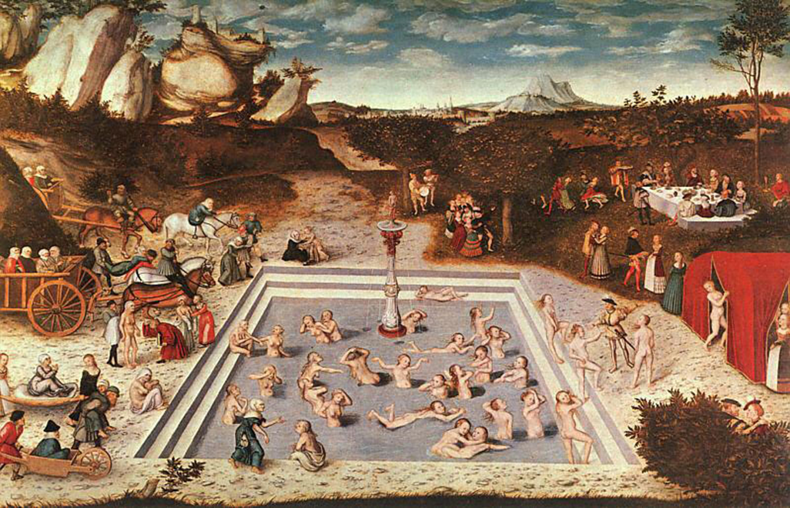
we have been there before...
1546, Lucas Cranach, d. Ä. ( 1472-1553)

Slide 12
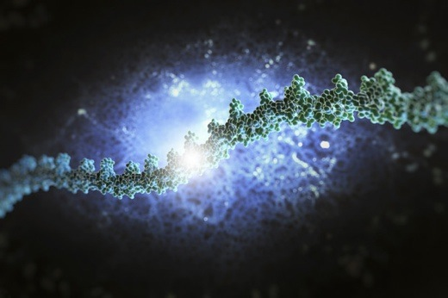
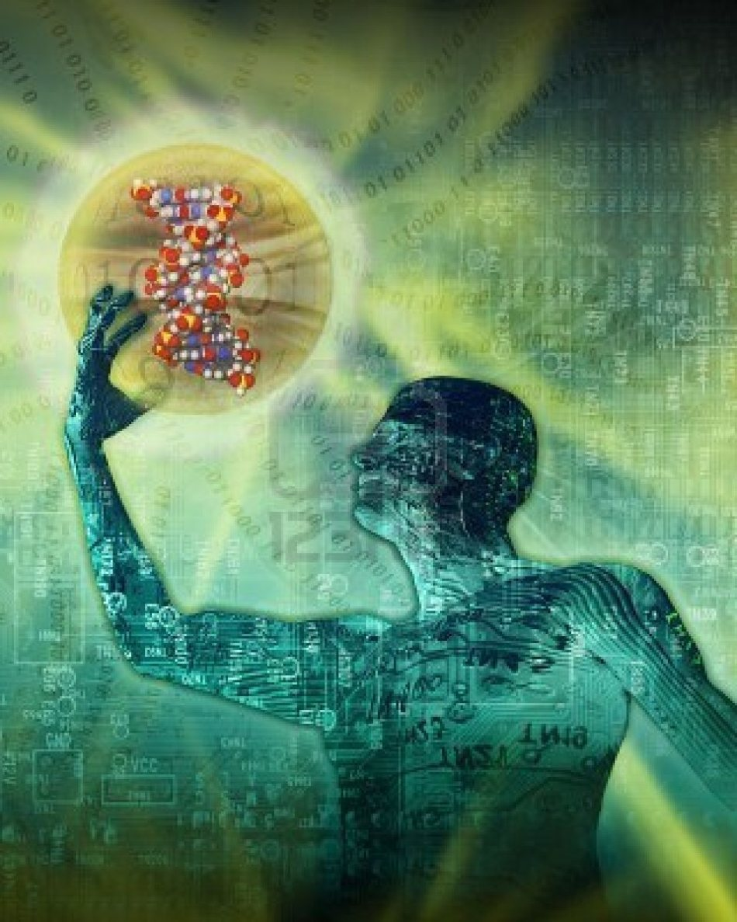
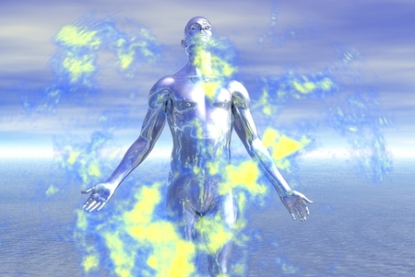
... in the land of genomic promise
http://islandbreath.blogspot.co.at/2012/09/dna-junk-and-health.html
http://www.riseearth.com/2012/11/genetically-modified-humans-new-gene.html
http://www.dailygalaxy.com/my_weblog/2009/01/are-we-close-to.html

Slide 13
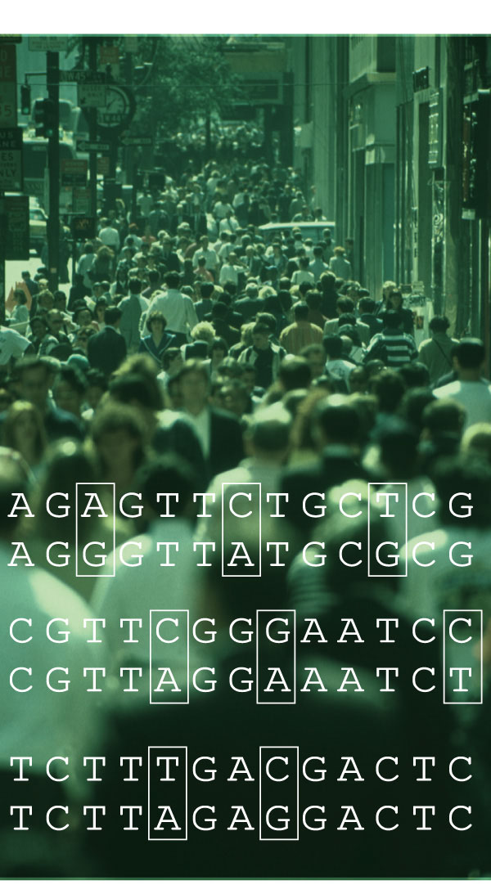

„People want everything. That’s their problem“.
Richard Powers, Gain, 1998
http://bgiamericas.com/applications/human/
http://www.nature.com/nature/journal/v409/n6822/fig_tab/409822a0_F1.html

Slide 14
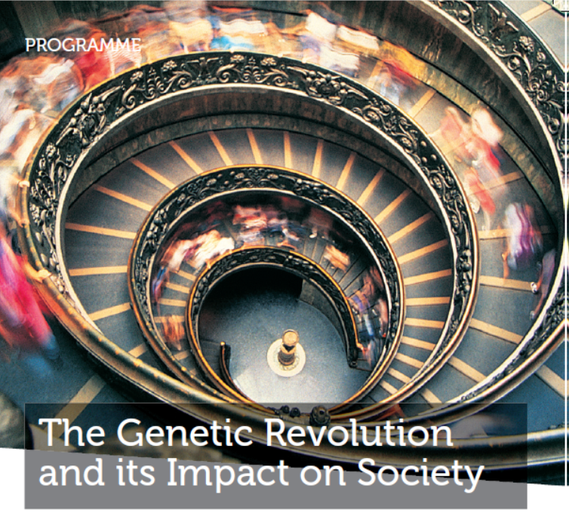
Promises – some fulfilled, many only partly, others unfulfilled
… glacial pace of clinical translation

Slide 15
What does a promise do?
Elicits hope and expectations
Leads to disappointment when not fulfilled
Repeated disappointments: loss of trust and sometimes legitimacy
Citizens science: a more realistic relationship?
Matching of promises with societal aspirations and expectations

Slide 16
Between fear and confidence
What is a promise and what does it do
Policy – options and impact
Publics and collective imaginaries
The cunning of uncertainty

Slide 17
Policy – mediating the tension between science and democracy
Enhancing beneficial outcomes, minimizing or eliminating harmful ones
In practice: limitations of citizens’ participation and governmental accountability; winners and losers
Legislation, court decisions, technical advisory committees, regulatory assessments, NGOs activities, controversies... the burdens of regulation

Slide 18
Policy – what we know, what we would like to know and what we should know
Science Speaks to Power, D. Collingridge & C. Reeve (1986): an unhappy marriage; failures of science trying to influence policy; only incrementalism works; the regulatory dilemma
Balance between creating spaces for innovation/options and constraining them

Slide 19
National policies differ
The same scientific facts elicit different political responses
Techno-political imaginaries and regimes (G. Hecht, 1998, The Radiance of France. Nuclear Power and National Identity after WW2)
The imaginaries of the absent: the case of Austria (U.Felt)
Civic epistemologies: culturally specific ways of knowing (Sh. Jasanoff)

Slide 20
The framing of policy: the larger picture
Governments mostly expect short-term economic returns; socio-economic impact
NPM and governance by numbers: monitor, compare, benchmark, impact assesment
Numerical complexity reduction: figures, indicators, algorithms and their Eigendynamik
Evidence-based-policy: whose evidence, how assembled, in which context to be used
Performativity

Slide 21
Assessing future impact
Impact is a military metaphor: hitting the target with maximum precision and effectiveness
Mega-projects as target (moon landing, Human Brain Project) largely conceived as engineering projects
What if target cannot be defined precisely?
Compare US War on Cancer with recent progress
Limits of prediction: failure of technological predictions

Slide 22
Assessing future impact, ctd.
Seeks to eliminate uncertainty
Narrows options and space for discovery
Expels surprise and serendipity
The usefulness of useless Knowledge (A.Flexner 1939)
Is there sufficient science in the pipeline for radical innovation? R. Gordon vs. J. Mokyr

Slide 23
Between fear and confidence
What is a promise and what does it do
Policy – options and impact
Publics and collective imaginaries
The cunning of uncertainty

Slide 24
The public dimension of science and innovation
Meeting the public, discovering publics: from PUS to PAS to PES, what next ?
Scientist: why don’t people care about science? Public: why don’t scientists care about people? (Pew Survey, Public praises science; scientists fault public; C. Safina, 2012)
Where is the place of people in our knowledge?

Slide 25
Evidence based policy – questions of legitimacy and authoritativness
Who can argue against evidence?
But whose evidence, how assembled, by whom, in which context?
Decontextualization and recontextualization
National policy boundaries: How local/national is EBP?
Does it deepen the lay – expert divide?

Slide 26
The experience of today’s life world
The life world (Husserl, 1936): gap between scientific explanation and grounding facts of every day life
Evidence through senses and everyday forms of cognition
Validity of life world evaluated (reality check) through intersubjective experience: peers, social media, language, institutions, trust

Slide 27
Scientific evidence meets life world evidence: an ambivalent mixture
Varies with domain (nanotechnology; GMO; vaccinations; synbio; fracking...)
Varies with sense of control: voluntary or involuntary
In need of careful differentiation (Onora O’Neill on trust)
Place in people’s lives

Slide 28
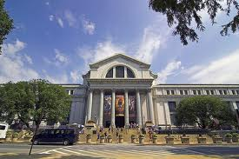
Encountering people‘s life world
„ The genomic revolution is here – are you ready?“
American Museum of Natural History, 2001

Slide 29
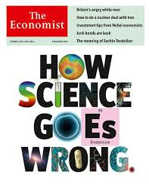
The changing public image of science
19 Oct 2013
17 Oct 2013

Slide 30
The public image of science: tensions and contradictions
Peer-review system bursting at seams
The replication crisis (John Ioannidis)
Can science still validate and certify scientific results?
OA and access of public through internet
Crowd funding and citizen science e.g. GalaxyZoo, Fold-it; etc. on the rise

Slide 31
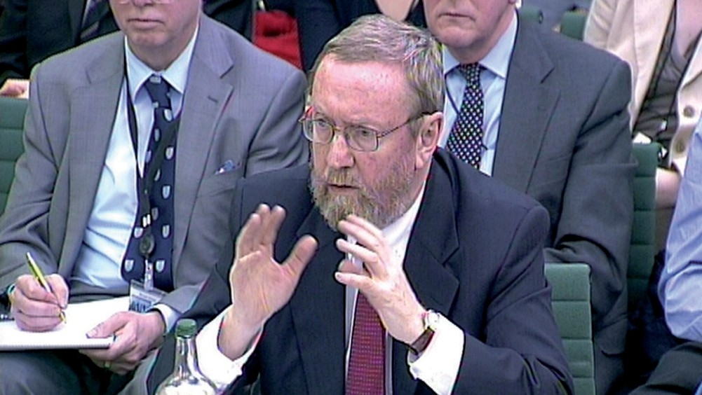
Institutionalized re-assurance
The UK chief scientific adviser, John Beddington, has overseen the installation of science advisers in every department of the British government.
Beyond the great and good
Chief scientific advisers need better support and networks to ensure that science advice to governments is robust, say Robert Doubleday and James Wilsdon. Nature Vol 485, 17 May 2012

Slide 32
Institutionalized re-assurance: the office of CSA
CSA – a product of one political culture and part of an advisory system
Works best for emergencies: decision-making under intense time-pressure, linked to immediate decision of do or don’t
Comparable to re-insurance
Difficult to achieve at EU level

Slide 33
The role of collective (political) imaginaries
A democracy must be imagined and performed by multiple agents in order to exist (Y. Ezrahi, 2013)
Disintegration of external reality i.e. Nature, justification of political order
Reversal: from image to reality rather than from presumed reality to representations
New space for politics and ethics to choose collective imaginaries to shape common life

Slide 34
Between fear and confidence
What is a promise and what does it do
Policy – options and impact
Publics and collective imaginaries
The cunning of uncertainty

Slide 35
The cunning of uncertainty
Science thrives at the cusp of uncertainty
Frontier research and innovation are inherently uncertain
If science can thrive on uncertainty – why not society?
Learning to embrace uncertainty
Openness toward the future: an evolving system

Slide 36
Embracing uncertainty
The ubiquity and evolution of error
Towards a culture to learning from mistakes
Innovation is also inherently uncertain –linear model obsolete
E/value/action is a fundamental cultural activity

Slide 37
The Odds for Tomorrow
“Contrary to what managers, engineers, politicians and risk experts want to make us believe, it is the massive mobilization of the population, of dissident experts and of victims which have led ministerial departments, industrialists, safety committees and courts of justice to modify their attitudes”.
(D. Pestre, 2013, A Contre-Science. Politiques et savoirs des sociétés contemporaines, p.151)

Slide 38
The cunning of uncertainty
It doesn‘t matter how beautiful your theory is, it doesn‘t matter how smart you are. If it doesn‘t agree with experiment, it‘s wrong. That‘s all there is to it.
Richard P. Feynman
Knowledge continues to evolve – and we do not know yet what we will know in the future
Sir Karl Popper

